Slide 1
भारतीय सनदी लेखाकार संस्थान
(संसद के अधिधनयम द्वारा स्थाधित)
THE INSTITUTE OF CHARTERED ACCOUNTANTS OF INDIA
(Set up by an Act of Parliament)
About Peer Review Board of ICAI
Presented by:
CA HARI RAM AGARWAL
B.Com.(H), LL.B., FCA,FCS,DISA(ICAI), Insolvency Professional

Slide 2
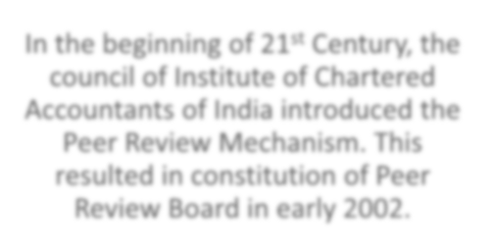
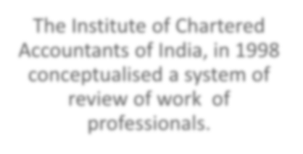
भारतीय सनदी लेखाकार संस्थान
(संसद के अधिधनयम द्वारा स्थाधित)
THE INSTITUTE OF CHARTERED ACCOUNTANTS OF INDIA
(Set up by an Act of Parliament)
Inception of Peer Review
In the beginning of 21st Century, the council of Institute of Chartered Accountants of India introduced the Peer Review Mechanism. This resulted in constitution of Peer Review Board in early 2002.
The Institute of Chartered Accountants of India, in 1998 conceptualised a system of review of work of professionals.

Slide 3
भारतीय सनदी लेखाकार संस्थान
(संसद के अधिधनयम द्वारा स्थाधित)
THE INSTITUTE OF CHARTERED ACCOUNTANTS OF INDIA
(Set up by an Act of Parliament)
Elements of Peer Review
Board :
Board shall be constituted by the Council.
Practice Unit :
means a firm of Chartered Accountants or a member in Practice, practicing whether in an individual name or a trade name or such other entity as recognized by the ICAI from time to time.
Reviewer :
means a member duly approved and empanelled by the Board on fulfilling the qualifications prescribed for a Reviewer as per Peer Review Guidelines.

Slide 4
भारतीय सनदी लेखाकार संस्थान
(संसद के अधिधनयम द्वारा स्थाधित)
THE INSTITUTE OF CHARTERED ACCOUNTANTS OF INDIA
(Set up by an Act of Parliament)
Peer Review - Meaning
What is Peer Review?
Peer Review means an examination and review of the systems and procedures to determine whether the same have been put in place by the Practice Unit for ensuring the quality of assurance services as envisaged by the Technical, Professional and Ethical Standards as applicable including Audit Quality Maturity Model wherever applicable or any other regulatory requirements as may be prescribed by the Council or any Committee and whether the same were consistently applied during the period under review.

Slide 5
भारतीय सनदी लेखाकार संस्थान
(संसद के अधिधनयम द्वारा स्थाधित)
THE INSTITUTE OF CHARTERED ACCOUNTANTS OF INDIA
(Set up by an Act of Parliament)
Object of Peer Review
Peer Review aims to ensure that the assurance services rendered by the members:
comply with Technical, Professional and Ethical Standards as applicable
including other regulatory requirements.
have in place proper systems including documentation thereof, to amply demonstrate the quality of the assurance services.

Slide 6
भारतीय सनदी लेखाकार संस्थान
(संसद के अधिधनयम द्वारा स्थाधित)
THE INSTITUTE OF CHARTERED ACCOUNTANTS OF INDIA
(Set up by an Act of Parliament)
Peer Review Guidelines, 2022
In exercise of the powers conferred by Section 15(2)(fa) of the Chartered Accountants Act, 1949, the Council issued the Peer Review Guidelines, 2022.
These Guidelines contain complete code relating to Peer Review process, including the terms of reference of such reviews, role & responsibilities of all the parties concerned, role and functions of the Board etc.
The Council also introduced AQMM Review alongside peer review for statutory auditors of listed entities, banks and insurance companies.

Slide 7
भारतीय सनदी लेखाकार संस्थान
(संसद के अधिधनयम द्वारा स्थाधित)
THE INSTITUTE OF CHARTERED ACCOUNTANTS OF INDIA
(Set up by an Act of Parliament)
Peer Review Process
⁽⁴⁾ Reporting
(3)
Execution
(2)
Planning
(1)
Selection of Practice Unit and
appointment of Reviewer

Slide 8
भारतीय सनदी लेखाकार संस्थान
(संसद के अधिधनयम द्वारा स्थाधित)
THE INSTITUTE OF CHARTERED ACCOUNTANTS OF INDIA
(Set up by an Act of Parliament)
Eligibility to become a Peer Reviewer
A member in practice
having experience of at least 7 years of assurance practice OR
having experience of at least 10 years in the employment
+
at least 3 years audit experience
+
he is in whole time practice at the time of enrollment
and
has undergone One day training for Peer Reviewers & cleared the online test conducted by the Board.

Slide 9
भारतीय सनदी लेखाकार संस्थान
(संसद के अधिधनयम द्वारा स्थाधित)
THE INSTITUTE OF CHARTERED ACCOUNTANTS OF INDIA
(Set up by an Act of Parliament)
Eligibility to become a Peer Reviewer
A member shall not be eligible if
Any disciplinary action / proceeding is pending with member.
Member has been found guilty of professional or other misconduct.
Member has been convicted by a competent court whether within or outside India, of an offence involving moral turpitude and punishable with imprisonment.
NOTE:
A Peer Reviewer shall not accept any professional assignment from the Practice Unit for a period of two years from the date of appointment. Further, he should not have accepted any professional assignment from the Practice Unit for a period of two years prior to the date of appointment as a Peer reviewer of that Practice Unit or its partners in case of a firm.

Slide 10
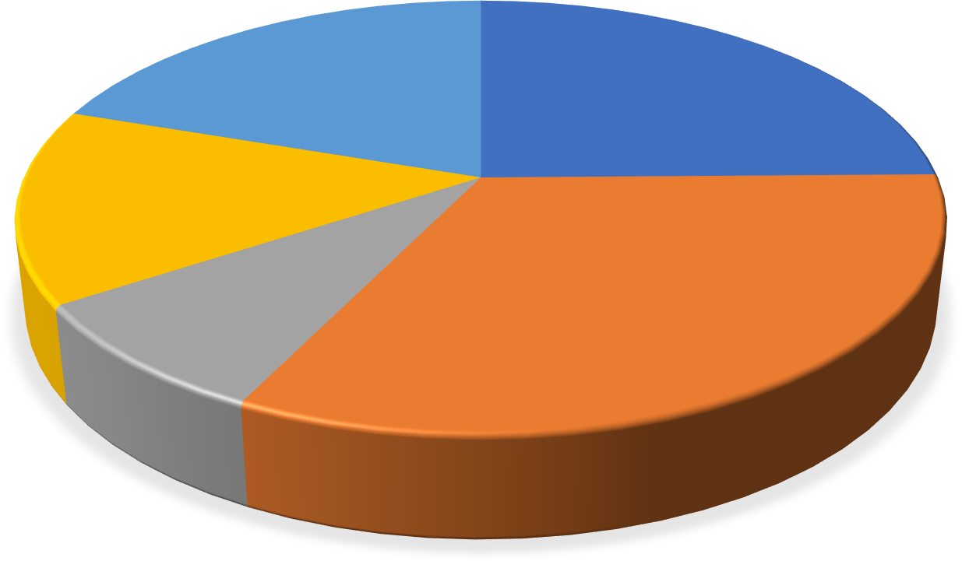
भारतीय सनदी लेखाकार संस्थान
(संसद के अधिधनयम द्वारा स्थाधित)
THE INSTITUTE OF CHARTERED ACCOUNTANTS OF INDIA
(Set up by an Act of Parliament)
Region wise No. of Peer Reviewers
TOTAL NO. OF REVIEWERS = 4079
Western Region, 806
Northern Region, 1010
Southern Region, 593
Eastern Region, 346
Central Region, 1324

Slide 11
भारतीय सनदी लेखाकार संस्थान
(संसद के अधिधनयम द्वारा स्थाधित)
THE INSTITUTE OF CHARTERED ACCOUNTANTS OF INDIA
(Set up by an Act of Parliament)
Peer Review Recognition by Regulators
Securities & Exchange Board of India (SEBI)
With effect from April 1, 2010, SEBI mandated that the Limited Review/Statutory Audit reports submitted to the concerned stock exchanges by the Listed Entities shall be given only by those auditors who have been subjected to peer review process and hold a valid certificate issued by the ‘Peer Review Board’ of the ICAI.

Slide 12
भारतीय सनदी लेखाकार संस्थान
(संसद के अधिधनयम द्वारा स्थाधित)
THE INSTITUTE OF CHARTERED ACCOUNTANTS OF INDIA
(Set up by an Act of Parliament)
Peer Review Recognition by Regulators
Comptroller & Auditor General of India (C&AG)
The Comptroller & Auditor General of India (C & AG) has revised the Policy of Empanelment of CA Firms/LLPs and appointment of auditors of Companies under Section 139(5) and 139(7) of the Companies Act 2013 and of Statutory Corporations/Autonomous Bodies as per the provisions of their respective Acts.
A maximum of 25 points have been allotted to firms which hold a Peer Review Certificate for empanelment.

Slide 13
भारतीय सनदी लेखाकार संस्थान
(संसद के अधिधनयम द्वारा स्थाधित)
THE INSTITUTE OF CHARTERED ACCOUNTANTS OF INDIA
(Set up by an Act of Parliament)
Peer Review Mandate-Roll Out Implementation
Phase I applicable with effect from 01.04.2022
Practice Units which propose to undertake Statutory Audit of enterprises whose equity or debt securities are listed in India or abroad as defined under SEBI (Listing Obligations and Disclosure Requirements) Regulations.
Peer Review Mandate Already applicable
Phase II applicable with effect from 01.07.2024
Practice Units which propose to undertake Statutory Audit of unlisted public companies having paid-up capital of not less than rupees five hundred crores or having annual turnover of not less than rupees one thousand crores or having, in aggregate, outstanding loans, debenturesand deposits of not less than rupees five hundred crores as on the 31st March of immediately preceding financial year: For these Practice Units, there is a pre-requisite of having Peer Review Certificate.
OR
Practice Units rendering attestation services and having 5 or more partners: For these
Practice Units, there is a pre-requisite of having Peer Review Certificate before accepting
any Statutory audit.

Slide 14
भारतीय सनदी लेखाकार संस्थान
(संसद के अधिधनयम द्वारा स्थाधित)
THE INSTITUTE OF CHARTERED ACCOUNTANTS OF INDIA
(Set up by an Act of Parliament)
Peer Review Mandate-Roll Out Implementation
Phase III applicable with effect from 01.07.2025
Practice Units which propose to undertake the Statutory Audit of entities which have raised funds from public or banks or financial institutions of over Fifty Crores rupees during the period under review or of any body corporate including trusts which are covered under public interest entities: For these Practice Units, there is a pre-requisite of having Peer Review Certificate.
OR
Practice Units rendering attestation services and having 4 or more partners: For these Practice Units, there is a pre-requisite of having Peer Review Certificate before accepting any Statutory audit.
Peer Review Mandate becoming applicable during the Year 2025-26
Phase IV applicable with effect from 01.01.2026
Practice Units which propose to undertake audits of branches of Public Sector banks : For these Practice Units, there is a pre-requisite of having Peer Review Certificate
OR
Practice Units rendering attestation services and having 3 or more partners: For these Practice Units, there is a pre-requisite of having Peer Review Certificate before accepting any Statutory audit.

Slide 15
भारतीय सनदी लेखाकार संस्थान
(संसद के अधिधनयम द्वारा स्थाधित)
THE INSTITUTE OF CHARTERED ACCOUNTANTS OF INDIA
(Set up by an Act of Parliament)
Year wise No. of Peer Review Certificates issued
No. of Certificates issued
2853
3000
2500
2000
1500
1410
1255
1325
1327
1236
1002
1169
1030
1000
895
784
879
736
716
600
410
489
522
447
523
500
302
22
0
As on 11th April 2025, 6397 CA firms have valid Peer Review Certificate.

Slide 16
भारतीय सनदी लेखाकार संस्थान
(संसद के अधिधनयम द्वारा स्थाधित)
THE INSTITUTE OF CHARTERED ACCOUNTANTS OF INDIA
(Set up by an Act of Parliament)
Cost of Peer Review
Minimum fee recommended for Practice Units where the period of Review is 3 years:
Average gross receipts * | Fees | Fees for PU conducting Statutory Audit of Listed entities | Fee for only AQMM Review, if conducted separately
Upto Rs 10 lacs p.a. | Rs 15,000 | Rs. 18,000 | Rs. 5,000
Over Rs 10 lacs upto Rs. 50 Lacs p.a. | Rs 25,000 | Rs. 30,000 | Rs. 5,000
Over Rs 50 lacs upto Rs. 1 crore p.a. | Rs 40,000 | Rs. 48,000 | Rs. 5,000
Over Rs 1 crore upto 3 crore p.a. | Rs 60,000 | Rs. 72,000 | Rs.10,000
Over Rs 3 crore upto 5 crore p.a. | Rs 75,000 | Rs. 90,000 | Rs.10,000
Over Rs 5 crore p.a. upto 10 crore p.a | Rs 1,50,000 | Rs. 1,80,000 | Rs. 20,000
Over Rs. 10 crore p.a upto Rs. 20 crore p.a. | Rs. 2,00,000 | Rs. 2,40,000 | Rs. 20,000
Over Rs. 20 crore p.a upto Rs. 30 crore p.a. | Rs. 3,00,000 | Rs. 3,60,000 | Rs. 25,000
Over Rs. 30 crore p.a. | Rs. 5,00,000 | Rs. 6,00,000 | Rs. 30,000
* For calculating Average gross receipts/ revenue from assurance service clients of Practice Unit (Per Annum) the sum total of gross receipts/ revenue from assurance service clients for all the periods under review shall be divided by number of years under review.

Slide 17
भारतीय सनदी लेखाकार संस्थान
(संसद के अधिधनयम द्वारा स्थाधित)
THE INSTITUTE OF CHARTERED ACCOUNTANTS OF INDIA
(Set up by an Act of Parliament)
Activities Envisaged for 2025-26
Strengthen sufficient and competent resources for review by organizing refresher courses for the existing Peer Reviewers and improve the quality of training for empanelment of new Reviewers.
Develop suitable measures for educating/ creating awareness amongst the Practice Units about the peer review process and various requirements therefor.
Ensure ease of doing peer review by automation of peer review process.

Slide 18
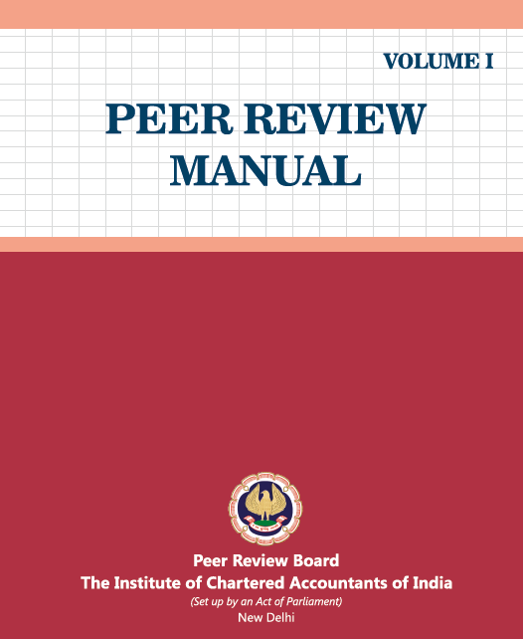
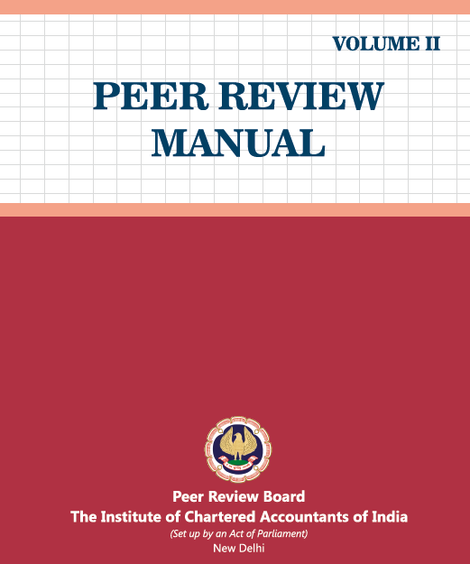
भारतीय सनदी लेखाकार संस्थान
(संसद के अधिधनयम द्वारा स्थाधित)
THE INSTITUTE OF CHARTERED ACCOUNTANTS OF INDIA
(Set up by an Act of Parliament)
Publications of Peer Review Board

Slide 19
भारतीय सनदी लेखाकार संस्थान
(संसद के अधिधनयम द्वारा स्थाधित)
THE INSTITUTE OF CHARTERED ACCOUNTANTS OF INDIA
(Set up by an Act of Parliament)
 | Thank you..!!!
Peer Review Board
The Institute of Chartered Accountants of India

